Slide 2
Trust Building for Team Building: Drama as a tool to break the ice, foster positive group dynamics, and encourage creativity

Slide 3
About Me
Communications Specialist, Wisconsin Alliance for Infant Mental Health

Slide 4
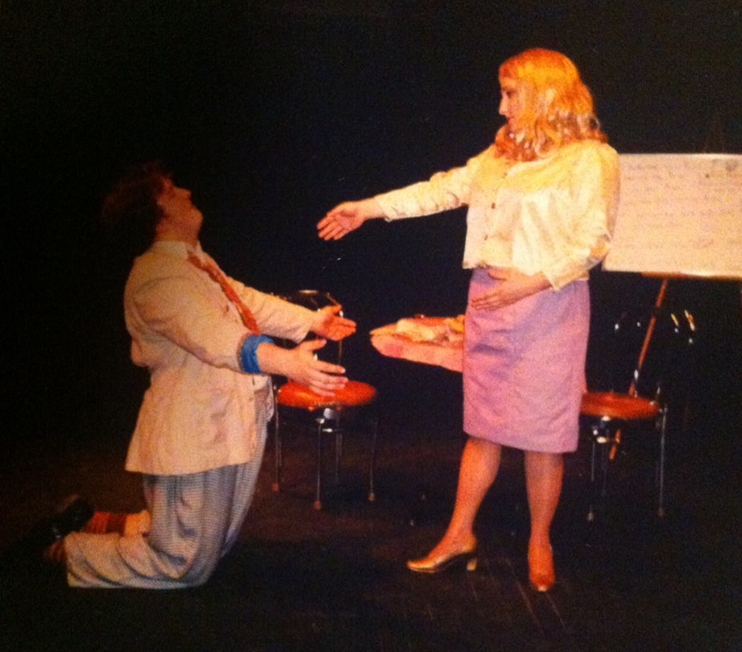

Slide 5
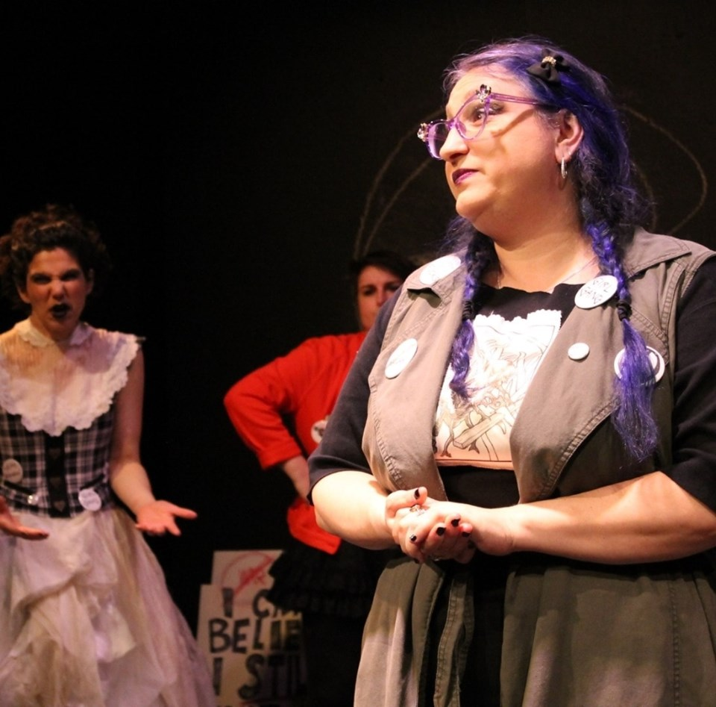
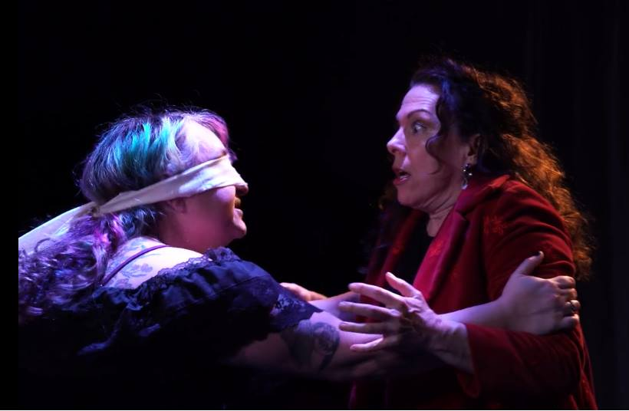

Slide 6
Benefits of Drama
Encourages creativity
Promotes adaptive thinking
Fosters empathy
Notes:
Encourages Creativity – Especially in improv, you have to think quickly and creatively to be a captivating performer
Promotes Adaptive Thinking – Anything can happen onstage, you have to be ready to support your team. You have to make quick decisions and commit to them 100% to be a convincing actor
Fosters Empathy – Playing all kinds of roles, you have to explore a variety of backgrounds and behaviors.

Slide 7
Benefits of Drama
Helps reflect upon and process emotions
Builds trust!

Slide 8
This can apply to your IMH work!

Slide 9
Warming Up
Getting in tune with your group

Slide 10
Exercise 1: Counting
Group stands in a circle. The goal is for the group to count to a certain number (for example, 10 or 20), without any verbal prompting or visual cues regarding who will speak next, without a member of the group interrupting another. If someone does interrupt someone else, go back to “one” and begin again until the final count is reached.

Slide 11
Exercise 2: Problem/Solution
A: “I have a problem:_______ (describe problem)”
B: “Here, I have a _________(random object)”
A: “Great! I can then (do something with the object) to __________ (come up with a solution). Thank you!”

Slide 12
Exercise 3: Secret
Split into pairs. One half of the pair is the “secret holder” and the other half is the person who will receive the secret. The secret holders stand on one side of the room, the receivers on the other. The secret holders will think of a secret to tell the receiver. After taking a moment to establish eye contact with each other, the exercise begins.

Slide 13
Processing/Discussion
How did these exercises make you feel?
What did you notice?

Slide 14
Questions?

Slide 15
Thank you!

